Slide 1
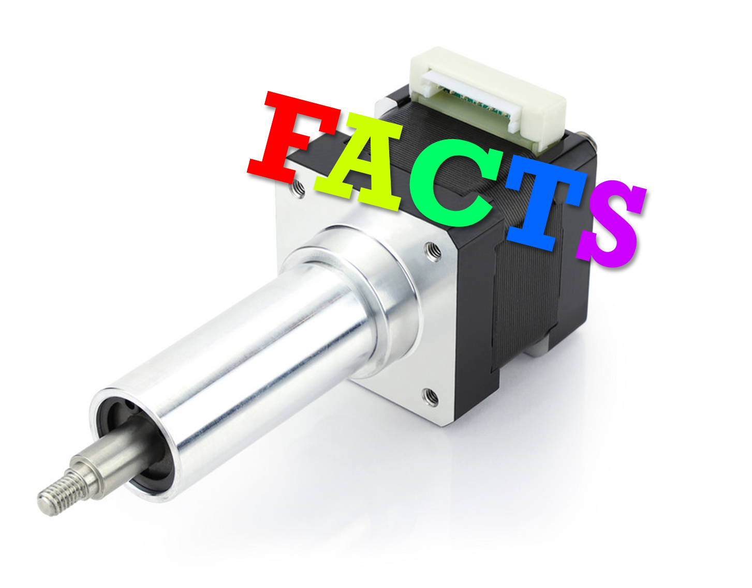

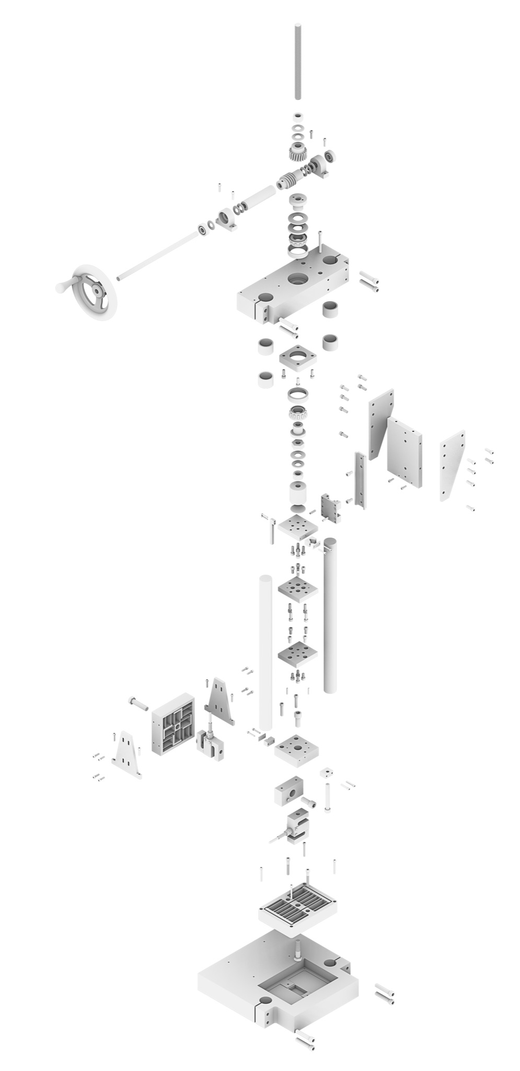
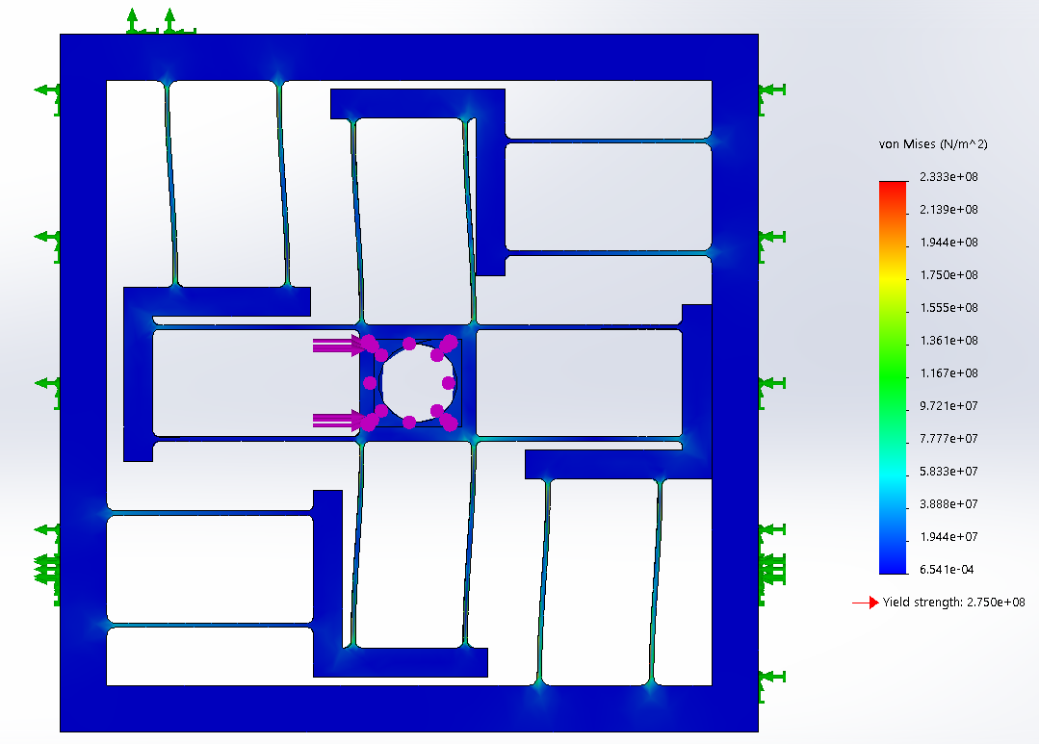
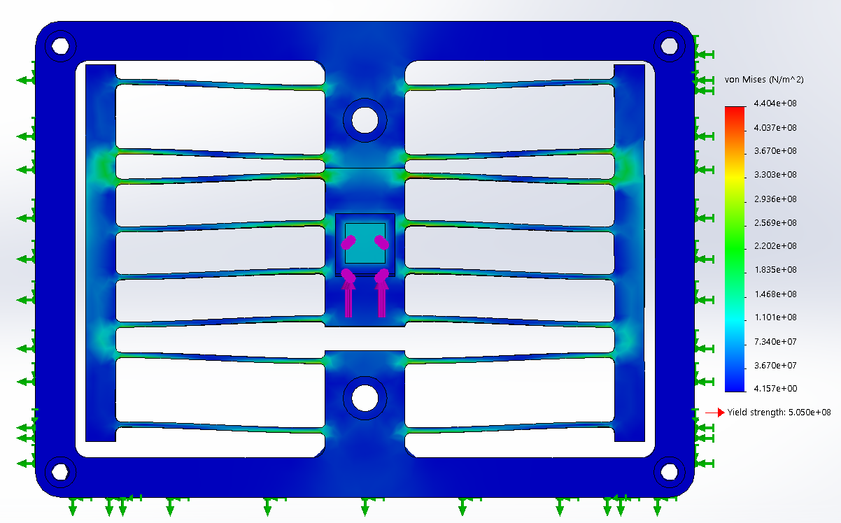
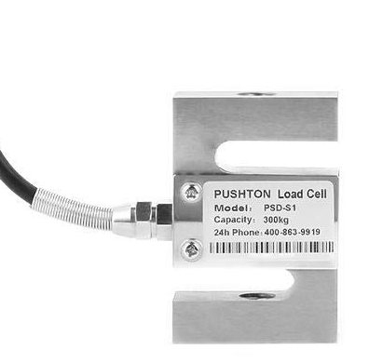
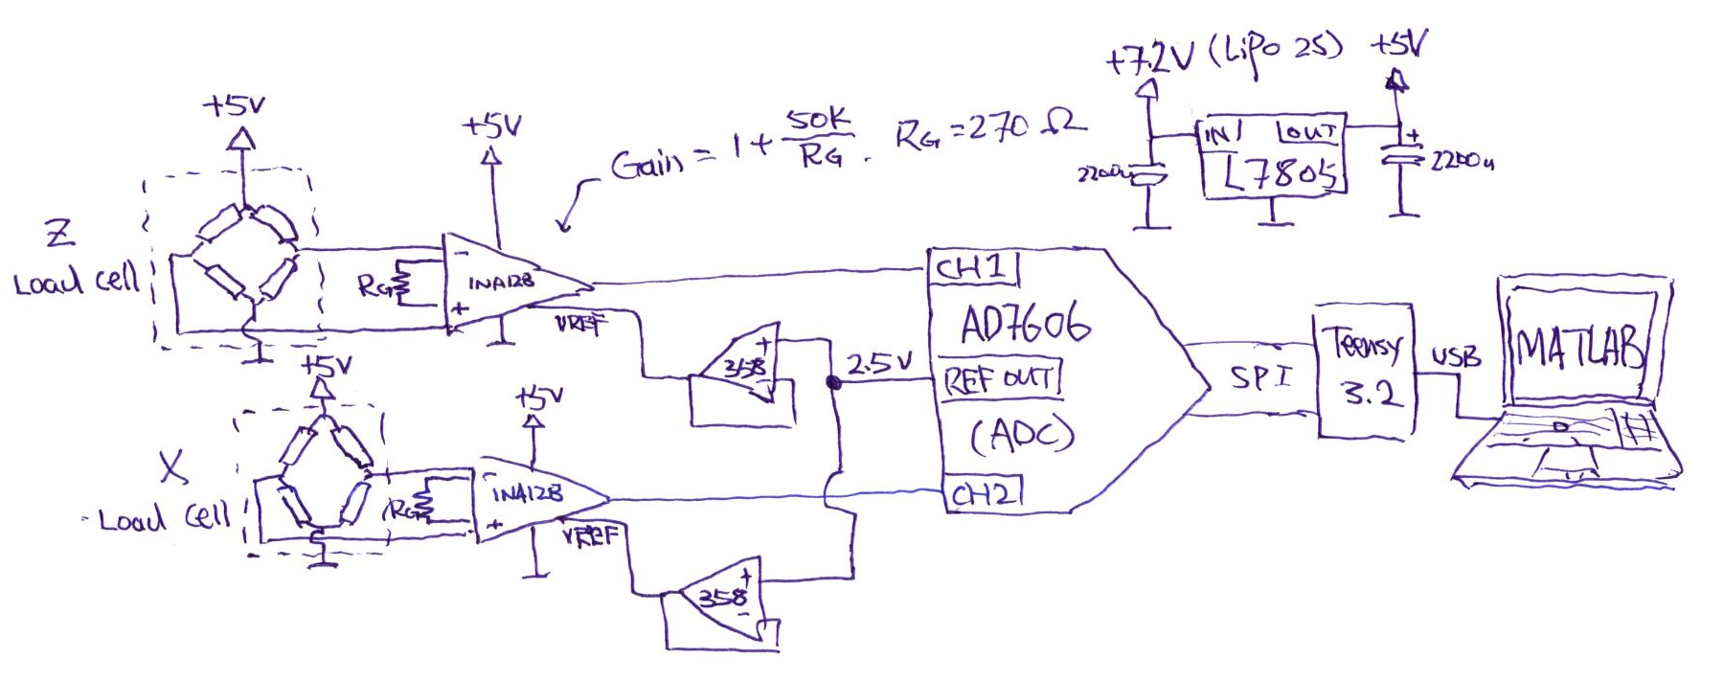
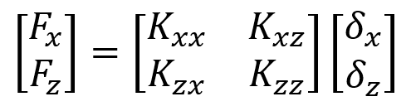
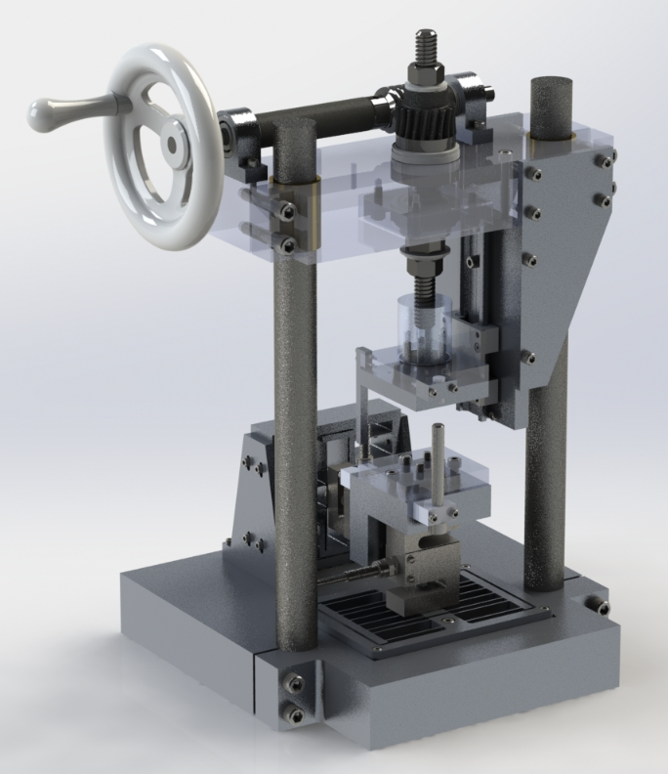
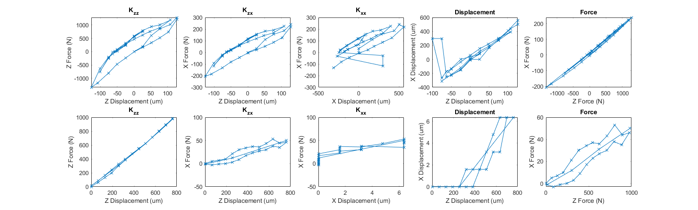
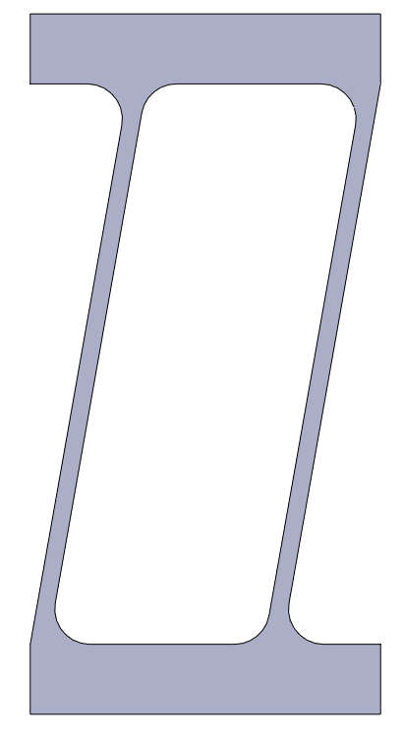
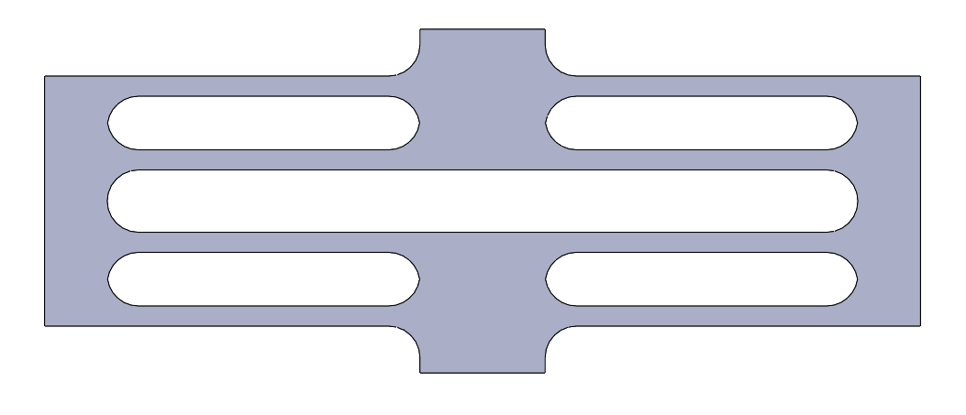
Two-Axis Stiffness Flexure Tester
FACTuators: Dylan Fife, Qiyun (Q) Gao, Ben Hamilton, Zain Karsan, ZhiYi (Z) Liang
2.77 Precision Product Design (Fall 2021)
Project Objectives
Machine Layout
Transmission
This machine is designed to measure the 2-dimensional stiffness matrix of a flexure specimen. It is designed to test flexures with stiffness ranging between 10⁻¹ to 10¹ N/um in the stiff direction (Z) and 10⁻² to 10⁰ N/um in the compliant direction (X). The machine is designed to be capable of delivering up to 10 kN force with a maximum travel of 6.5mm. The fabricated machine is capable of meeting all the functional requirements listed below.
The force delivery transmission of the machine is designed to consist of a hand-crank, a set of worm-gear, and a lead-screw mechanism. The design enables low torque input achievable by an average person (~5Nm) to deliver a high force output to the specimen (~10kN), while maintaining high displacement resolution (0.3mm per handle turn). The manually operated hand-crank drives a 10:1 worm gear mechanism to deliver 10x mechanical advantage and convert horizontal rotary motion into vertical rotary motion. The worm gear then drives a 5/8-8 ACME lead screw mechanism to convert rotary motion into linear translation with up to 10kN force delivery capability. The entire mechanism is designed to have at least an safety factor of 2.
High Level FR
Metrology Frame
Functional Requirements |  | Proposed [Force|Distance] |  | Measured [Force|Distance]
Accuracy | z | 100N | 0.02mm | 1N | 0.01mm
 | x | 10N | Fixed | 1N | N/A
Repeatability | z | 100N | 0.02mm | 10N | 0.01mm
 | x | 10N | Fixed | 10N | N/A
Resolution | z | 100N | 0.02mm | 1N | 0.005mm
 | x | 10N | Fixed | 0.3N | N/A
Range | z | 10kN | 2mm | >10kN | 6.5mm
 | x | 1kN | Fixed | >1kN | N/A
Force and distance are measurements decoupled from machine compliance by a metrology frame. X and Z force measurements are taken with load cells, and are decoupled from each other by flexures with relative stiffness of >100:1, along with load cell orientation. Distance measurement is taken directly at the interface where forces are delivered to the specimen. Dial indicators are used for distance measurements. This design decouples the force delivery mechanism from the metrology frame to ensure maximum accuracy.
Data Acquisition
Fundamental Theory
Forced applied to Z and X axis are sensed by load cells with capacity of 1000kgf and 300kgf respectively, and sensitivity of 2mV/V full scale. Output of load cells are amplified by a pair of instrumentation amplifiers with gain set to 185, producing output of 5.3N/mV on Z and 1.6N/mV on X. Amplified voltage is then sampled by a 16-bit ADC. A live-plot interface with zeroing capability is implemented in MATLAB. Acquired data is averaged with a 200ms sliding window before plotting. The force measurement accuracies are listed in the FR table.
Metrology frame enables direct measurements of F_{x}, F_{z}, 𝛿_{x}, and 𝛿_{z}. Measurements must be taken twice to calculate all stiffnesses
Characterizations
Strength Test:
Tested up to 9.5kN in z-axis before electronics are saturated, imposed an additional 1 turn afterward and confident that the hardware sustained 10kN load. Also tested parasitic sideload up to 1kN in X by applying 4.5kN in Z to a slanted structure.
Specimen Stiffness Test:
A slanted blade and a straight blade flexure specimen are fabricated with known stiffness and tested with the machine. The machine measurement vs FEA stiffness is shown in the following table. Measured data are shown with 95% confidence interval.
Flexure | Stiffness | FEA | Measured
Slant | K_zz | 90.9 N/um | 10 ± 8.3 N/um
 | K_xx | 3.38 N/um | 0.4 ± 0.53 N/um
 | K_xz | 15.5 N/um | 1.8 ± 1.4 N/um
Straight | K_zz | 1.23 N/um | 1.27 ± 0.27 N/um
*Potential error contribution in FEA simulations due to improper constraints setup
Slanted
Straight
Future Works
There were a couple areas with overconstraint that could be fixed with future work
Rail flexure on the coarse Z adjustment
Stiffer linear guide for force application and better x-axis runout isolation
Addition of X movable stage for direct k_xx measurement
Acknowledgements
Our team would like to thank the following individuals and communities: Prof. Martin Culpepper and Marcel Thomas of MIT Mechanical Engineering, MIT Edgerton Center, MIT GEAR Lab, MIT Architecture Workshops, MIT Laboratory for Manufacturing and Productivity, MIT MakerWorkshop, Q’s dog, Zain’s dog
December 8th, 2021

